Slide 1






VEHICLE CLASSIFICATION USING ANN ON NVIDIA DGX100

Slide 2
TEAM MEMBER
Raj Srivastava (2200290140121)
Session:2023-2024(4th Semester)
UNDER THE SUPERVISION OF
Mr. Prashant Agrawal
Associate Professor
KIET Group of Institutions,Delhi-NCR Ghaziabad

Slide 3
TABLE OF CONTENTS
Introduction
Software Requirements
Hardware Requirements
Modules
Outputs
Conclusion
Gantt Chart
04
05
06
07
08
09
10

Slide 4
INTRODUCTION
This Project introduces an approach to vehicle classification using artificial neural networks on the NVIDIA DGX100 platform. It highlights the system's ability to learn complex features from raw vehicle images for robust classification across multiple classes.

Slide 5


SOFTWARE REQUIREMENTS
Operating system: Windows 10/11.
IDE Tool: PyCharm
Coding Language: Python 3.6
APIs: Keras, OpenCV, NumPy, Matplotlib, CUDA

Slide 6
HARDWARE REQUIREMENTS
Processor: Pentium i5 or higher.
RAM: 8 GB or higher.
Hard Disk Drive: 50 GB (free).
Peripheral Devices: Monitor, Mouse and Keyboard

Slide 7

MODULES
Neural Network Architecture
Data Acquisition
Model evaluation
01
02
03
04
05
06
Data Preprocessing
Model training
Model deployment

Slide 8

OUTPUT
The output of this project is a high-accuracy vehicle classification system capable of real-time performance, making a efficient urban traffic management.

Slide 9



CONCLUSION
The project concludes the successful research paper on a robust vehicle classification system, highlighting its accuracy, scalability, and real-time performance, and its potential for enhancing urban traffic management.

Slide 10
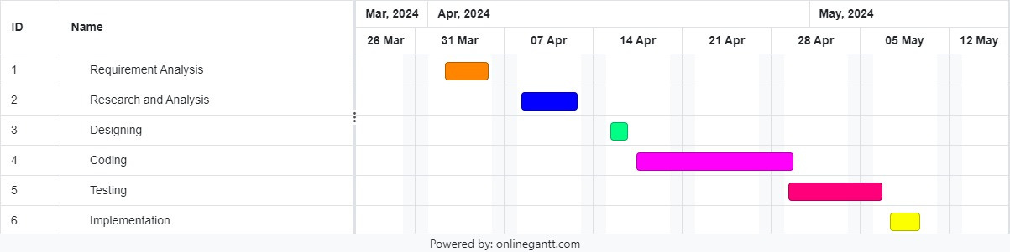
GANTT CHART

Slide 11

THANK YOU!

